Slide 1


SEARCHABLE ENCRYPTION USING BLOCKCHAIN FOR A CLOUD DATABASE
SRI KRISHNA COLLEGE OF TECHNOLOGY
MENTOR : MS.M.KAVITHA MARGRET
HAYAGRIVE ATHRAY K
KISHANTH C
PRASATH R

Slide 2
ABSTRACT
Since the advent of cloud database storage, data providers have had to migrate their management systems of data from on-premises cloud providers to private cloud providers to benefit from greater flexibility and cost savings.
However, to protect data confidentiality, sensitive data must be encrypted before outsourcing. So we have used MRSE technique .
To meet the demand for quality information, search services need to support multi-word queries and provide consistent results, taking into account the number of users, data and information stored in cloud storage.
Similar search encryption uses less variable searching rather than focusing on a single keyword or Boolean keyword search.

Slide 3
OBJECTIVE
The primary objective of this study is to develop and implement a secure cloud storage using the Multi Keyword Ranking Searchable Encryption (MRSE)
The system aims to ensure the confidentiality of cloud database by reducing the size of the file , thereby increasing storage
By using MRSE encryption techniques, the research seeks to provide a comprehensive solution that facilitates fine-grained access control and secure storage of HI within a healthcare cyber-physical system, while considering resource constraints and usability concerns.

Slide 4
LITERATURE REVIEW
BLOCKCHAIN-ASSISTED SECURE FINE-GRAINED SEARCHABLE ENCRYPTION FOR A CLOUD-BASED HEALTHCARE CYBER-PHYSICAL SYSTEM
Mamta, Brij B et.al has proposed in this system The concept of sharing of personal health data over cloud storage in a healthcare-cyber physical system has become popular in recent times as it improves access quality. The privacy of health data can only be preserved by keeping it in an encrypted form, but it affects usability and flexibility in terms of effective search. Attribute-based searchable encryption (ABSE) has proven its worth by providing fine-grained searching capabilities in the shared cloud storage. However, it is not practical to apply this scheme to the devices with limited resources and storage capacity because a typical ABSE involves serious computations. In a healthcare cloud-based cyber-physical system (CCPS), the data is often collected by resource-constraint devices; therefore, here also, we cannot directly apply ABSE schemes. In the proposed work, the inherent computational cost of the ABSE scheme is managed by executing the computationally intensive tasks of a typical ABSE scheme on the blockchain network.

Slide 5
SECURE FINE-GRAINED KEYWORD SEARCH WITH EFFICIENT USER REVOCATION AND TRAITOR TRACING IN THE CLOUD
Brij B. Gupta et.al has proposed in this system Fine-grained searching is an important feature in multi-user cloud environment and a combination of attribute-based encryption (ABE) and searchable encryption (SE) is used to facilitate it. This combination provides a powerful tool where multiple data owners can share their data with multiple data users in an independent and differential manner. In this article, the authors have used key-policy design framework of attribute-based encryption to construct the multi-keyword search scheme where access rights assigned to a data user are associated with his/her secret key. This leads to a situation where a data user can abuse his secret key to distribute it illegally to the unauthorized users perform search over the shared data which is not intended for him/her. Therefore, to track such kind of key abusers the authors have embedded an extra functionality of tracing the traitors.

Slide 6
EXISTING SYSTEM
The challenge addressed in this research is the need to securely share and store personal health data in a healthcare cyber-physical system (CCPS) using cloud storage while preserving privacy.
While encryption ensures privacy, it hinders effective search and usability. The proposed solution combines attribute-based searchable encryption (ABSE) with blockchain technology to overcome this challenge.
By offloading computationally intensive ABSE tasks, particularly system initialization, to the blockchain's consensus nodes, the scheme enables efficient fine-grained searches on encrypted health data, making it practical for resource-constrained CCPS devices.
This approach ensures decentralized control, data privacy, and computational efficiency in managing and retrieving personal health data.

Slide 7
DRAWBACKS
Attribute-based search encryption (ABSE) has proven its value by providing effective search capabilities in cloud sharing.
However, since ABSE always requires complex numerical calculations, it is not possible to use this method on devices with limited resources and storage capacity.
Because cloud-based cyber-physical systems (CCPS) often use limited equipment to collect data for medical treatment, ABSE technology cannot be directly applied to these situations.
Therefore, the recommendations in the CCPS regarding the storage and retention of private medical information online are followed. The scheme, which uses blockchain technology, has two main benefits.

Slide 8
PROPOSED SYSTEM
We have researched and developed a comprehensive framework for the MRSE Framework using this proprietary framework.
Keyword privacy is very important because most people don't want other people, like the Edge-Fog-Cloud server, to see their searches.
An intermediate similarity measure known as "coordinate matching" measures the document's relevance to the query by keywords count of the query that appear in the document.
In order to search more keywords, we recommend using "keywords in similarity" to evaluate the "coordinate match" similarity index.
To design search schemes which allow multi-keyword query and provide result similarity ranking for valuable data retrieval, instead of returning undifferentiated results.

Slide 9
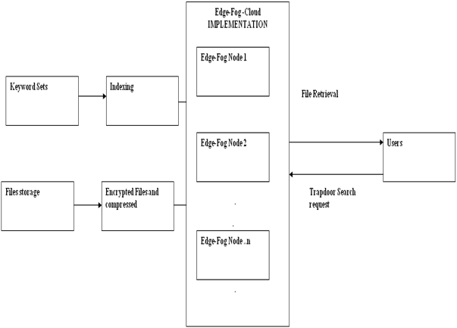
ARCHITECTURAL DIAGRAM

Slide 10
DATA FLOW DIAGRAM
Start
Data Encryption
Edge-Fog Cloud Setup
Cipher text Coordinates Matching
Data Privacy and Analysis
Keyword Privacy
Efficiency and Privacy
Result Display
End

Slide 11
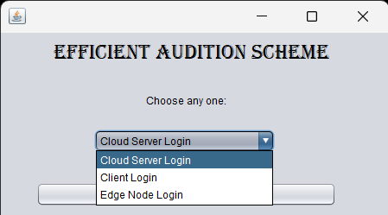
IMPLEMENTATION

Slide 12
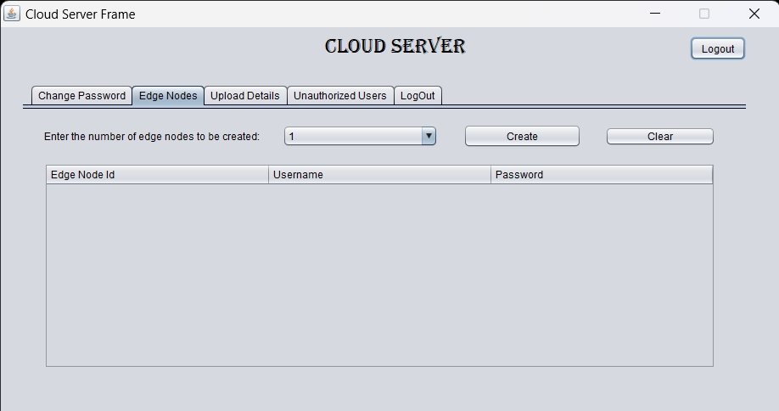
CLOUD SERVER

Slide 13
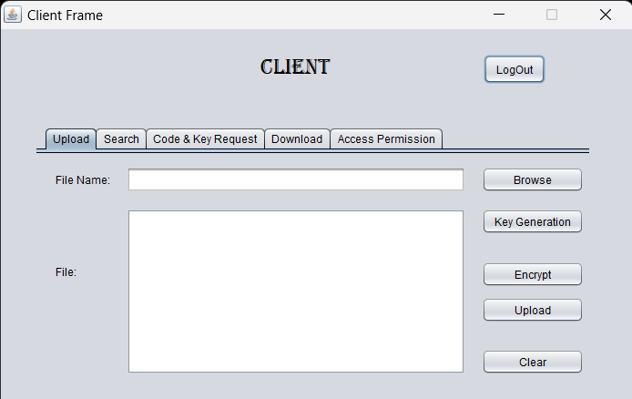
CLIENT SERVER

Slide 14
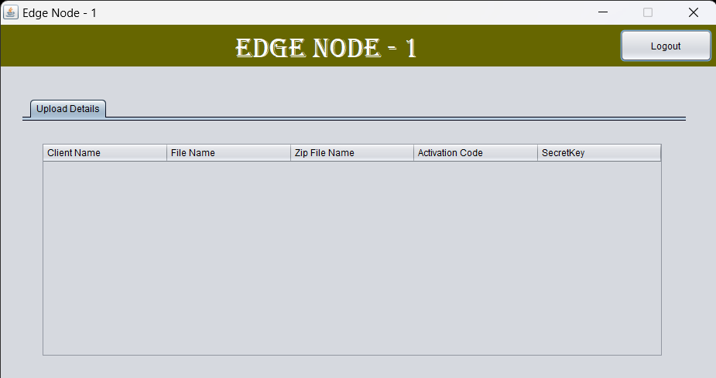
EDGE NODE

Slide 15
CONCLUSION
In conclusion, in terms of privacy protection, efficiency, scalability, and computational overhead, the suggested privacy criteria and solution for MRSE offer a considerable improvement over current ABSE frameworks.
Through the resolution of the primary issues raised by MRSE users, the suggested solution enhances MRSE's feasibility and appeal for a range of application scenarios.
The application process can be used for many systems, including distributed file systems, local search engines on devices, and cloud-based search services.

Slide 16
REFERENCES
[1].Y. Miao, J. Ma, X. Liu, F. Wei, Z. Liu, and X. A. Wang, “m 2-ABKS: Attribute-based multi-keyword search over encrypted personal health records in multi-owner setting,” J. Med. Syst., vol. 40, no. 11, p. 246, 2021.
[2].Mamta and B. B. Gupta, “An attribute-based keyword search for mHealth networks,” J. Comput. Virol. Hacking Tech., pp.1–16, 2020.
[3].Y. Miao, R. Deng, X. Liu, K.-K. R. Choo, H. Wu, and H. Li, “Multiauthority attribute-based keyword search over encrypted cloud data,” IEEE Trans. Dependable Secur. Comput., 2020. DOI: 10.1109/TDSC. 2019.2935044
[4].L. Chen, W.-K. Lee, C.-C. Chang, K.-K. R. Choo, and N. Zhang, “Blockchain based searchable encryption for electronic health record sharing,” Futur. Gener. Comput. Syst., vol.95, pp.420–429, 2020.
[5].Y. Wang, A. Zhang, P. Zhang, and H. Wang, “Cloud-assisted EHR sharing with security and privacy preservation via consortium blockchain,” IEEE Access, vol.7, pp.136704–136719, 2021.

